Slide 1
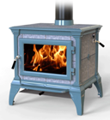
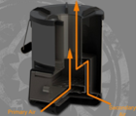
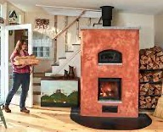
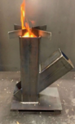
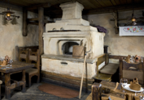
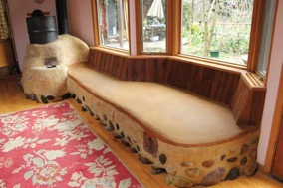
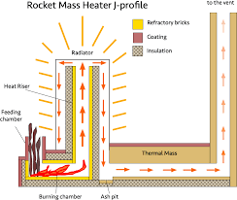
Wood Burning Stove
Wood Stove
Rocket Stove
Rocket Stove
Masonry Heater
https://tempcast.com
counter-flow design
(hot air goes up, then down the sides, then back – and into chimney
Rocket Mass Heater
Russian Stove

Slide 2
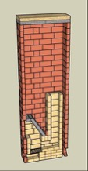
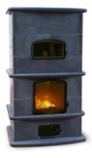
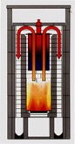
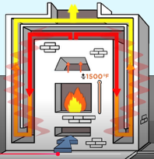
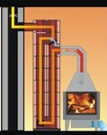
Cross-flow vs Bell
Recent research and practical experience suggest that the bell design is increasingly favored for its simplicity and adaptability, especially in rocket mass heaters and hybrid systems. The bell design allows for larger internal volumes and more flexible layout, not strictly adhering to the principle of constant cross-sectional area throughout the system, which can still result in excellent performance and clean combustion
https://www.handprintpress.com/tech/recent-research-on-rocket-mass-heaters-and-bell-design/
https://www.firespeaking.com/masonry-heaters/rocket-mass-heaters/rocket-mass-heater-cookstove/
https://permies.com/t/102393/Horizontal-bench-vertical-bell
https://donkey32.proboards.com/thread/2171/double-masonry-heater-suggestions-welcome
http://heatkit.com/docs/shabaldin/Basics%20for%20the%20design%20of%20wood..htm
https://www.mha-net.org/docs/admin/Manual.pdf
http://www.stovemaster.com/html_en/designsystem.html
https://masonrymagazine.com/blog/2017/09/01/masonry-heaters-and-wood-fired-bake-ovens/
http://forum.driveonwood.com/t/masonry-heaters/7155?page=3
Masonry stoves/heaters are highly efficient wood-burning heating systems that store and radiate heat over long periods
Two prominent design philosophies are cross-flow and bell (or chamber) systems. Here’s a comparison of their key features and differences:
Cross-Flow Design - Hot gases from the firebox pass through a series of horizontal channels stacked vertically or horizontally, exchanging heat with the masonry mass as they move toward the chimney. The gases are forced to travel a long, winding path, maximizing contact with the masonry and thus heat transfer. The Construction - multiple flues or channels built into the masonry, often inspired by Finnish contraflow designs. Excellent heat transfer due to the extended path and large surface area in contact with the masonry. Can be more complex to build, requiring precise channel dimensions and careful masonry work.
Bell (Chamber) Design - Hot gases rise into one or more large chambers (bells), where they slow down and transfer heat to the surrounding masonry before exiting through the chimney. The gases naturally stratify within the bell—hotter gases rise, cooler gases descend - promoting efficient, passive heat exchange without the need for forced movement through narrow channels. Construction features one or more large chambers (bells) above the firebox, often with overlapping or connected chambers for enhanced heat retention and transfer. High efficiency due to natural convection and gas stratification; less prone to creosote buildup since gases are not forced through tight channels. Simpler to construct in some respects, but requires careful attention to chamber size and insulation to ensure proper gas flow and heat retention.
Cross-flow designs: https://tempcast.com
https://www.vermontwoodstove.com/masonry-heater/ Rocket stove + Bell designs: https://donkey32.proboards.com/thread/40/rocket-bell-stove

Slide 3
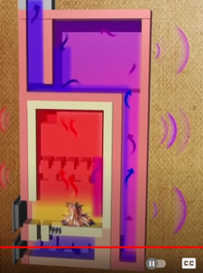
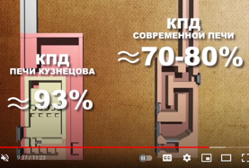
Kuznetsovs stove
93% efficiency
no smoke https://www.youtube.com/watch?v=gaXyWyDm2mk

Slide 4
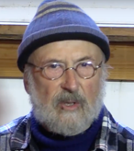
Peter van den Berg
Peter van den Berg - batch rocket feeding into a bell chamber
"batch rocket design feeding into a bell chamber" - hybrid solution combining batch rocket with Kuznetsov's bell system.
https://batchrocket.eu
https://batchrocket.eu/en/designs – designs
https://www.rocketstoves.com/case-studies/peter-van-den-berg/
https://www.youtube.com/@batchrocketproject4720
https://www.youtube.com/watch?v=VL7O8qLXz24
https://permies.com/t/156820/Experience-Kuznetsov-Stoves
https://roquetinho.eu/files/roquetinho-en.pdf – Roquetinho
https://www.handprintpress.com/tech/improving-woodstove-efficiency-rocket-stoves-masonry-heaters/
https://donkey32.proboards.com/thread/40/rocket-bell-stove – Rocket-Bell
http://www.bergkachel.nl
RMH = Rocket Mass Heater: 90% clean burning, long heat output
Rocket Combustion Core - uses a J-tube or L-tube design where wood burns vertically in a tube. Air enters from below, creating an intense, oxygen-rich burn. The combustion chamber is heavily insulated to maintain very high temperatures (1800°F+). This creates complete combustion with almost no smoke or emissions. It is called "rocket" because of noisy roaring sound
Mass Storage System - made of cob, adobe, brick, or stone (bench seating, sleeping platform, ...). Mass radiates heat for 12-24 hrs after fire dies out
Batch rocket - Load, light, walk away, enjoy heat for 12-24hrs
Hybrid solution: batch rocket feeding into a bell chamber. Hot gases from rocket exit into a bell-shaped chamber (like Kuznetsov's design). The bell acts as a heat trap using natural gas physics. Hot gases rise and swirl in the bell, giving up their heat. Cooled gases naturally sink and exit through a lower outlet. This hybrid solution is simpler than Kuznetsov stoves, proven performance, perfect for a DIY project
Peter van den Berg lives on the west coast of The Netherlands.
He is a retired boat repairman, spending most of his time experimenting with masonry - and Rocket Stoves.
He has been very active in the online discussions about Rocket Mass Heaters, bringing practicality, experience, and science.

Slide 5
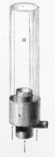
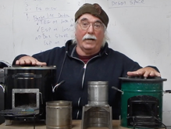
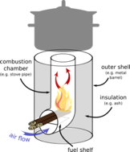
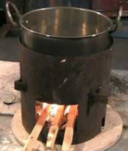
Rocket Stove
https://en.wikipedia.org/wiki/Rocket_stove
A rocket stove is an efficient and hot burning wood stove
Stove has an insulated hot vertical chimney (a "raiser") , where hot gases go up creating strong draft (pull) of gases through the system. It also ensures almost complete combustion
Rocket stoves most often used as portable stoves for cooking
Rocket stoves are also used for heating (rocket mass heaters)
In field tests in India, rocket stoves used 18.. 35% less fuel, compared to the traditional stoves
An Argand lamp (patented in 1780) was a precursor to the rocket stove. Its secret is simply a glass cylinder above the flame to increase air-flow. Same design was used for cooking and heating as it provides strongest heat without smoke.
Larry Winiarski (Aprovecho non-profit) began developing the rocket stove for developing countries in 1980 based on a VITA stove, designed by Sam Baldwin. A stove was designed to make tortillas and won an Ashden Award in 2005. Aprovecho won the same award in 2006 for their rocket stoves. Aprovecho rocket stoves were sold in Lesotho, Malawi, Uganda, Mozambique, Tanzania, and Zambia.
Aprovecho Research https://www.youtube.com/watch?v=SUHCsZHNMmg
Argand lamp (1780)
https://en.wikipedia.org/wiki/Ami_Argand
VITA Stove (early 1980s)
Rocket Stove
(uses heat insulation)

Slide 6

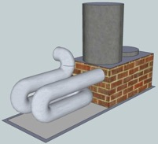
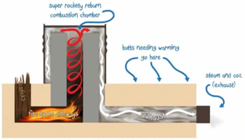
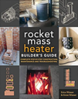

Rocket Stove – continued, Mass Heaters
http://my.waldenlabs.com/catalog/rocket-mass-heaters/ - resources
https://commonsensehome.com/rocket-mass-heaters/
https://richsoil.com/rocket-stove-mass-heater.jsp
https://www.youtube.com/watch?v=Sqznv5GDSWc
Book: The Rocket Mass Heater Builder's Guide
2016 by E.Wisner & E.Wisner
Book: Rocket Mass Heaters, 3rd Ed.
2014 by Ianto Evans, Leslie Jackson

Slide 7

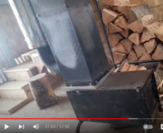
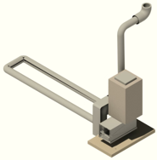
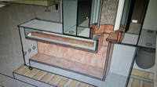
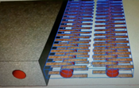
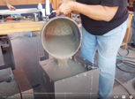
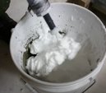
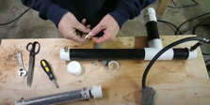
Super Efficient Homemade Stove
Honey Do Carpenter (Darwin Arnold)
Air Crete Rocket Mass Heater (improved)
https://www.etsy.com/shop/HoneyDoCarpenterShop
https://www.youtube.com/watch?v=eC3MITjo8M4&list=PLHsjz15Szmf3_7p4trNDtZGB15jIiW8Ko
https://www.kickstarter.com/projects/86171610/light-and-portable-rocket-mass-heater-design
The chimney pipe is heat-insulated, which creates strong draft and full combustion
Darwin Arnold & Melanie
Air Crete (Aerated Concrete)
a foam of cement + foaming agent (oil control hair shampoo)
https://www.youtube.com/watch?v=aSLJCPR1Prw
https://www.youtube.com/watch?v=DGhgFLruyaE

Slide 8
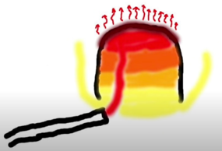
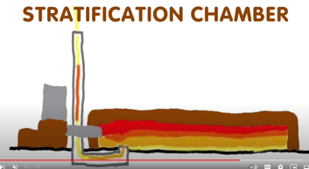

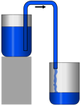

Stratification Chamber in a Rocket Mass Heater
https://www.youtube.com/watch?v=vXHmcKWfFw4
Hot air goes up,
cold air goes down
Hot air goes up, cold air goes down
Hot air goes up, cold air goes down
To understand how things work,
it helps to think about water going down
(similar to how hot air goes up).
Think about water, how you "prime the pump" by filling tubes with water,
then turn the diagram upside down,
and you will understand how hot air will behave.
.. https://www.youtube.com/watch?v=xOe_xSTqn1k
.. https://www.youtube.com/watch?v=452OyvGdzP4

Slide 9
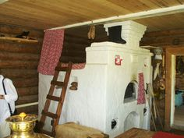
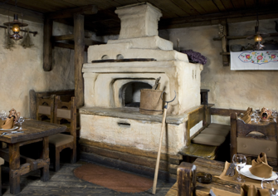
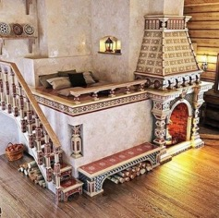
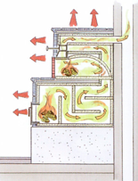
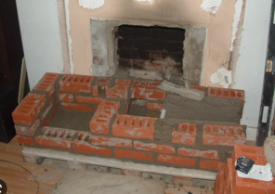
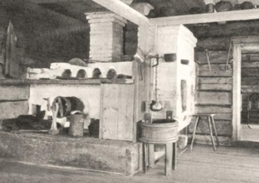
Russian Wood Stove

Slide 10
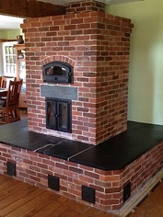
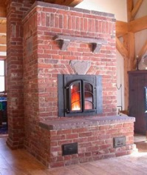
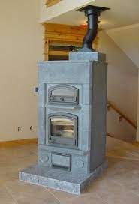
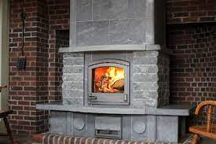
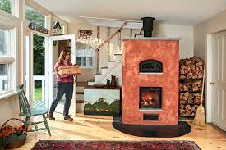
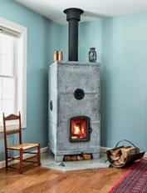
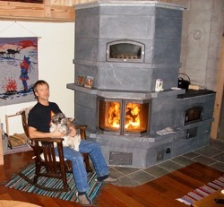
Masonry Heaters

Slide 11
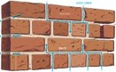
Bricks and Mortar
Firebricks and fire mortar can be purchased from Home Depot, Ace Hardware, and Lowe’s, as well as from local masonry supply stores and specialty refractory suppliers
To reimplement something like standard Tempcast core (24" x 36" footprint and 77" height), we will need 200-250 firebricks (brick size 9"x4.5"x2.5"; weight 7.3 lbs, cost $2-3) and 150 lbs of refractory mortar (3 50lb bags). So total weight 2,000 lbs.
Total costs: $750 for bricks and $200-$600 for mortar.
For masonry stoves, including masonry heaters like Tempcast, the mortar used must withstand both structural loads and repeated exposure to high temperatures. The most commonly recommended mortars for these applications are:
Type N Portland cement-lime mortar: This is suitable for above-grade brickwork and is commonly specified in building codes for the outer portions of masonry stoves and heaters. Type N mortar provides a good balance of strength (750 psi), workability, and flexibility, making it appropriate for the brick shells of heaters.
Refractory mortar: For areas directly exposed to flames and high temperatures, such as the firebox and inner linings, . This is the mortar supplied by Tempcast with their kits. This is a special high-heat or refractory mortar. This mortar is formulated to handle thermal cycling and direct flame contact, ensuring durability and safety. Refractory mortar is typically used with firebrick (ASTM C 64, medium duty) in the stove’s combustion chamber.
Type S or M mortar: These higher-strength mortars (1,800–2,500 psi) are sometimes used for load-bearing or below-grade parts of the structure, but are less common for the main body of a masonry heater unless higher compressive strength is specifically needed.
The bricks should be "refractory bricks" (a.k.a. fire bricks). These bricks are engineered to withstand the high temperatures and thermal cycling
These bricks are made from refractory ceramic materials such as clay, alumina, silica, and sometimes magnesia, which are capable of withstanding temperatures well above those produced by wood stoves (often up to 1800°C/3272°F or more)
Refractory bricks have high density and thermal mass, helping to absorb and retain heat for efficient operation and protection of the stove’s metal body
These bricks have low thermal conductivity. This property helps keep the outer shell of the stove cooler while the fire burns inside
Mechanical strength - bricks resist cracking from repeated heat/cool cycles
Standard Size: 9" x 4.5" x 2.5" (230 x 114 x 64 mm)
Insulating Fire Bricks (IFB) - lighter and more porous than standard fire bricks. These are sometimes used as insulating layers but are generally not recommended for direct flame exposure in wood stoves
Other Acceptable Materials: Vermiculite Boards - lightweight, heat-resistant boards that can be used as liners or insulation, but not as a replacement for refractory bricks in areas exposed to direct flame
Cast Refractory Panels - custom-shaped cast refractory panels, which are similar in function to fire bricks but are molded to fit specific stove designs
Tempcast components/modules/panels (Cast Refractory Panels ) are made from heat-resistant aggregates (look like gravel) and binders (look like cement) that allow it to be poured or molded into precise shapes
Aggregates is not gravel – it is mixture of alumina (aluminum oxide), silica (silicon dioxide), and sometimes magnesia (magnesium oxide) or crushed firebrick
The binder is a calcium aluminate cement (also known as high-alumina cement or "refractory cement")

Slide 12
Buying and Using a Wood Stove

Slide 13
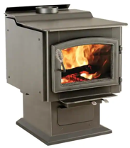
Wood Burning Stove (Hearth)
Hearth: (pronounced (/hɑːrθ/) like in "Heart")
: fireplace
: the floor of a fireplace, the lowest section of a furnace
: Очаг (in Russian)
Our property ~3K sqft (2K livable+1K basement). Suitable model at Home Depot: Ashley Hearth 3200 (number "3200" means "area 32000 sqft")
It is very good, has window to look at fire, big (22" logs)
Ashley Hearth 3200 model AW3200E-P
(same as US Stove model US3200E-P)
$2,450 at Home Depot (+200 tax, +100 delivery, +2,000 install = $4,750 total) Heating Area: 3,200 sq. ft.
BTU: 152,000
Weight: 400 pounds
Max Log Length: 22 inches Non-catalytic
https://www.homedepot.com/p/Ashley-Hearth-Products-3-200-sq-ft-EPA-Certified-Pedestal-Wood-Burning-Stove-with-Blower-AW3200E-P/313742319
In Canada they like another brand - "DROLET": .. https://www.drolet.ca/en/products/stoves/
Other examples: .. https://www.popularmechanics.com/home/g37791189/best-wood-stoves/
Many stores, for example: .. https://myfireplaceproducts.com/us_en/ht-3000-wood-stove-db07300
Installation cost typically $1,000 - $3000 (depends on how much ventilation work is needed) .. https://homeguide.com/costs/wood-stove-installation-cost .. https://www.houzz.com/cost/70-wood-stove-installation-cost

Slide 14
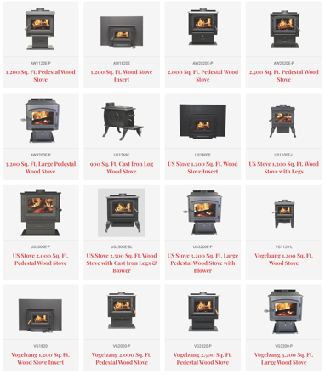
U. S. Stove Co (since 1869)
https://www.usstove.com/stoves/wood-stoves/
Ashley Hearth Products:
https://www.usstove.com/brand/ashley-hearth-products/
U.S. Stove acquired:
1994: Clayton Manufacturing
1996: Jensen Manufacturing
1998: Ashley division of Martin Industries
2012: Vogelzang International
So you can see basically the same stove being sold as Vogelzang or as Ashley Hearth

Slide 15
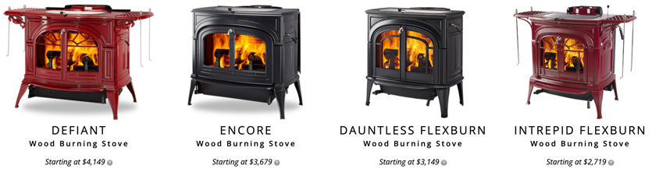
Vermont Castings wood stoves
.. https://www.youtube.com/watch?v=IqJehn5mb9k

Slide 16

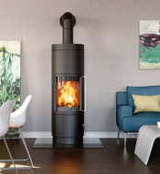

HearthStone Wood Stoves
https://www.hearthstonestoves.com/wood/wood-stoves/
TruHybrid™ = burns cleanly and efficiently using primary, secondary, and tertiary combustion
Deep Firebox (up to 21½” wide by 20½” deep)
Soapstone HeatLife - over 230lbs of soapstone are used to construct the Mansfield model to offer you plenty of long-lasting comfortable heat (assembled in Vermont).
Good Video:
https://www.youtube.com/watch?v=Sj8rDK4PXxM
Bari Plus
Model: 8172
German made

Slide 17




"3 ways I improved wood stove heating"
https://www.youtube.com/watch?v=iGZWx0gwRCo
1) insulated smaller burn chamber
(1/2 size of firebox)
2) Passive chimney heat reclaimer
3) adding thermo storage, (still need more of that)
- https://youtu.be/5-2NuTN_Yzs
- https://youtu.be/qg_s9IzF8sw
- https://youtu.be/hopXmMXrqAY
Wax
Passive chimney heat reclaimer
(cooling exhaust, tube-inside-tube)
Melted wax stores heat
better than sand or bricks

Slide 18

Five Best Wood Burning Stoves
https://www.youtube.com/watch?v=Df-sVM-hxrE
#1 - Vermont Casting - Cast iron, Beautiful color finishes, Top load.
#2 - Hearthstone - Catalytic Combustor - Soap Stone & Cast Iron, Longest burn time, most efficient, side load, rear vent.
#3 - Iron Strike 230 (originally "Country Stove") - Re-Burn System, Steel, Customizable, Different sizes, Blower attachment.
#4 - MF Fire Nova 2 - Catalytic Combustor - Insert & Freestanding, Nice burn.
#5 - Napoleon S Series - Re-Burn System – Steel - Strong brand name, Large viewing window, Shelf compartment.

Slide 19
Cast Iron Vs Steel Wood Burning stoves
- https://www.youtube.com/watch?v=yPtVhpHXg0E
Cast Iron Stoves .. Pros : More ornate, more colorful, traditional look, retains more heat .. Cons : Not Seamless, More Expensive
Steel Stove .. Pros : Clean & modern look, Cost effective, Seamless, Heats larger area .. Cons : Not as hot, Possibility of warping (because of overheating)

Slide 20


Catalytic Wood Stove
- https://www.youtube.com/watch?v=_DajfQQN7qM
A catalytic combustor = metal grid with special catalytic coating
that helps to re-burn the gasses and particulates.
It increases efficiency, fewer emissions, longer burn times (30+ hrs)
Secondary Burn
Secondary burn works by burning off the initial smoke produced from the fire that otherwise would have gone up the chimney.
You will often see a series of holes towards the top rear of the stove above the fire box that forces fresh oxygen over the chamber, reigniting this smoke.

Slide 21




Tips on Using Wood Burning Stoves
Stove Fans using Peltier effect: .. https://www.youtube.com/watch?v=Zd-93HLnkb4
Tips: https://www.youtube.com/watch?v=6uuhrdmfnqo
Use insulated tube from outside into the burning chamber to deliver air (to retain heated air inside the room)
Use tube with fan to suck hot air from around the stove to another room
Use Fans to circulate air
Store heat in bricks, sand, or wax
Increase draft (clean chimney, chimney fan)
Use seasoned wood
Directing the heat from the stove from basement to a living room upstairs https://www.youtube.com/watch?v=qZxJYOP13ME

Slide 22

Cold Air Intake
A home’s wood stove needs to breathe from somewhere
Problem:
Stove takes air from inside the room. The air pressure in the room goes down, and this causes a draft of cold air from doors, windows, and ventilation outlets into the room. This draft is cold - thus it reduces the effectiveness of the stove in warming the room.
Solution:
Construct an insulated pipe to deliver the air from outside directly into the bottom of the burning chamber of the stove.
This reduces the draft and improves te efficiency of the stove.
The pipe can be passive – or you can install a fan in the outer end to suck air into the pipe.

Slide 23





How to Run an Overnight Burn
https://www.youtube.com/watch?v=5oledpf2ocU
Fill stove with wood
How to start a wood stove
without it smoking?
https://www.youtube.com/watch?v=hmTkL5oUCDU
Regulate air intake
Regulate chimney damper
When starting, use dry paper and kindling to burn through the cold air plug.
Keep door open to get more air.

Slide 24






Portable Stove
SilverFire Survival Stove – best Rocket Stove SilverFire® Survivor 2nd Generation rocket stove .. https://www.silverfire.us/survivor-rocket-stove-p10 .. https://www.youtube.com/watch?v=oDGGlaVFqZU (2020) .. https://www.youtube.com/watch?v=IfBKBvTFgXo (2018) .. https://www.youtube.com/watch?v=ujsfXvWAd48 (2018) .. https://www.youtube.com/watch?v=8DwT-Vqy_Uc (2013)
Petromax Rocket Stove rf33 https://www.petromax.de/en/px-produkte/rocketstove-rf33/
SilverFire Scout Stove lightweight wood fired gasifier stove, that operates on just on twigs or flammable biomass
https://www.silverfire.us/304-stainless-steel-scout-stove

Slide 25

Commercial Pizza Ovens
Commercial Pizza Ovens (electric & gas)

Slide 26




Kerosene Lamp / Lantern
Cold-blast (1873)
"only fresh air is supplied to the burner, thereby increasing the brightness and stability of the flame"
2023 –$10 at amazon
https://www.amazon.com/dp/B000MKOWRU/
Dead-flame (1850)
"removing flickering by protecting from side winds"
Hot-Blast (1869)
"the wind supports the flame instead of extinguishing it"

Slide 27






Protect Hardwood Floor Near Fireplace
Stray ember or spark can fly and damage the floor
Use a Screen or Cover
Extend the Hearth
Use a hearth in front of the fireplace (bricks, tiles, stones)
Hearth Pad or Fireplace Rug (fire-retardant) - lay it in front of fire
https://www.amazon.com/dp/B07SHJ1RLN/
https://www.amazon.com/dp/B09WQT32B2/
Rug
Screen
https://www.amazon.com/dp/B015NRQ6OS/
https://www.amazon.com/dp/B015NRQA7G/
https://www.amazon.com/dp/B0BL29DRZT/
https://www.amazon.com/dp/B08FTJDK11/

Slide 28

Wiseway Pellet Stoves
https://www.youtube.com/watch?v=Kjyf4dBViic
https://www.wisewaypelletstove.com/specs/
https://www.wisewaypelletstove.com/
Natural gravity pellet feed lasts 24-36 hours
Silent
Weight 131 lbs
H x W x D x 52″ x 24″ x 15″
Price ~ $1,500
Can work non-stop for months
Easy to clean
5mm Ceramic glass
Efficiency Rating 75%
Heating Area 2,000 Square Feet
High Temp Burn: 10 hrs, 5.5 Lbs fuel/hr
Low Temp Burn: 30 hrs, 2 lbs fuel/hr
Heat Output 40,000 BTU
Certified and approved for use

